Slide 1
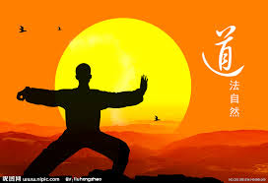
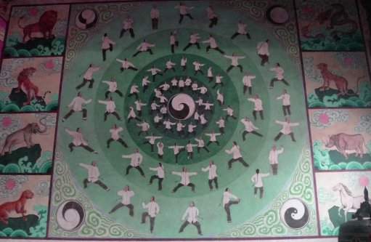
Let Us Play Tai Chi Nan Zhang

Slide 2
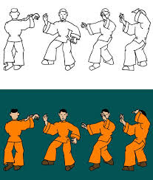
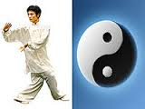
Tai Chi’s Symbol
All inclusive
Forgive
Tolerate
https://www.youtube.com/watch?v=NRpvkRKWDdc

Slide 3
What Tai Chi is
Tai Chi is Chinese traditional gong fu.
Tai Chi as a sport that good for health, especially good for some diseases, including Parkinson's disease, diabetes, cancer and arthritis.
Tai Chi is a beautiful art, an ancient philosophy.

Slide 4
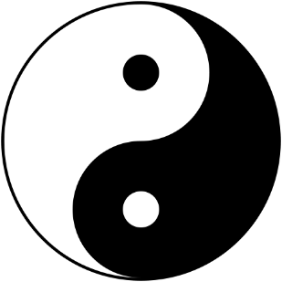
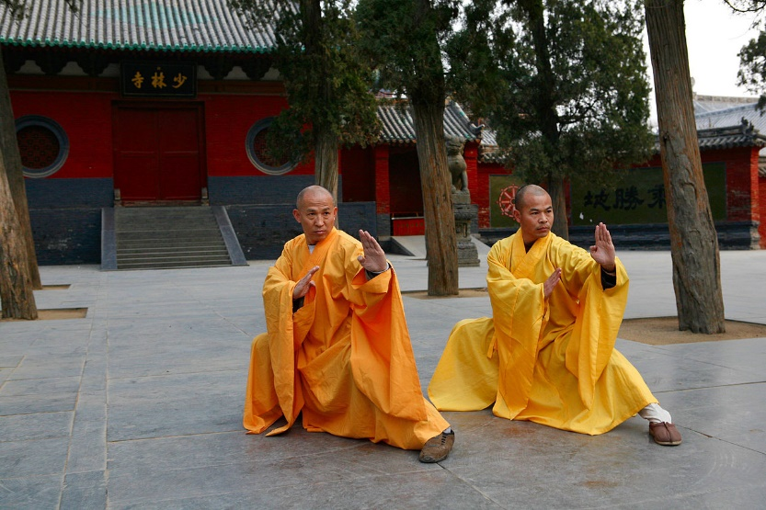
Historic origin of Tai Chi
Tai Chi is the concept made by Laozi who is the Chinese philosopher of around the 6th century BC.
The genesis of “Tai chi chuan” is believed in China from the 12th century, Taoism and Buddhism on Tai Chi development give great influence.
The term “Tai chi chuan" translates as
"boundless fist", or "great extremes boxing".

Slide 5
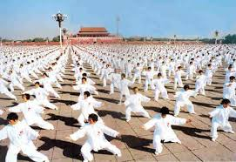
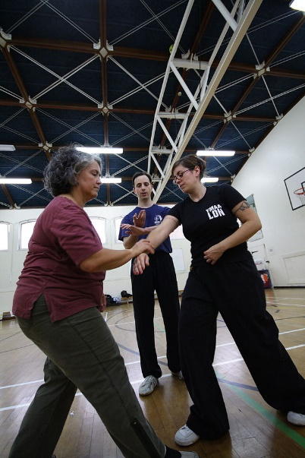

Slide 6
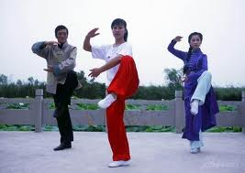
The effect of Tai Chi
After doing tai chi, player’s "heart" and "body" will become healthy.

Slide 7
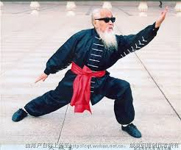
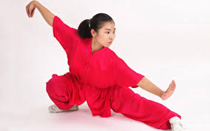
In order to play Tai Chi, "internal skill" and “breathing exercise" are important. "internal skill“ is energy which every people have.

Slide 8
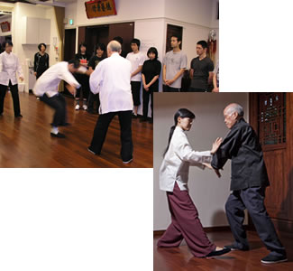
The basic action: push-hands (Tui Shou)
Push Hand is a kind of sparring of Tai chi. It is the technology integrated with offense and defense, which defense changes to an attack, and an attack changes to defense.
http://www.patiencetaichi.com/public/125.cfm

Slide 9
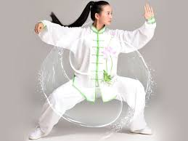
The basic action: cloud-hands (Yun Shou)
Wave hands like clouds; Gently slide your hand, like clouds flowing water;
Tai Chi exercise is beneficial to people‘s health, edify sentiment.
http://earthbalance-taichi.com/2013/10/chen-taiji-cloud-hands/

Slide 10
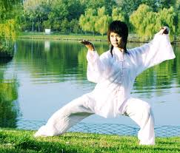
Beautiful Art
Practicing Tai Chi will make people’s feeling pleasant,
and woman's temperament elegant.
The dashing player

Slide 11
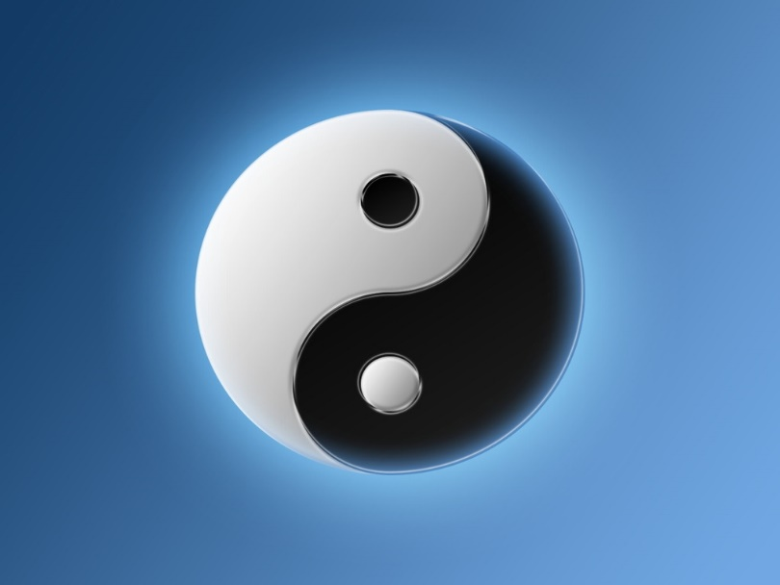
Rectangle and Circular : an ancient Philosophy
Control a hard thing with a soft power.
Your feeling will settle down when you play Tai Chi.

Slide 12
Angular
Rectangle Diamond Circular
A person's
opinion
As stiff as a poker
．．．
A person’s
opinion
The core without any change
The more contact with Tai Chi, the more calmer with your temperament

Slide 13
What can we learn from Tai Chi?
S
The reverse S-shaped
Mirror image
When you are carrying out something, you have to think not only for yourself, but also for your partner (a person, a company, or a country).

Slide 14
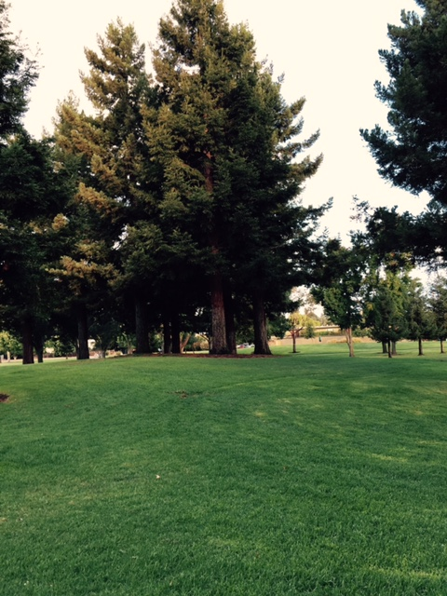
Thank you for your attention
I played tai chi in Whisman School Park every morning when I had been in Mountain View

